Slide 1

DIATECH Market & Sales LANDSCAPE
JCHYTECH version 13-11-2025

Slide 2
Market Trends
Strong increase in Pet dermatology consultations (+8–12%/year)
Rising pet ownership across EU
Owners demand rapid answers; less tolerance for guesswork
Insurance coverage expanding in FR/IT/ES
Clinics shift to rapid diagnostics for margin optimisation

Slide 3
Data on Pet Allergies
Dogs: 12–18% prevalence
Cats: 10–14% prevalence
Less than 25% of symptomatic cases tested
Symptoms: pruritus, skin lesions, respiratory signs

Slide 4
Data Pet Viral Diseases
Parvo, Distemper, Corona in dogs
Panleukopenia, Calicivirus in cats
Strong driver for rapid in-clinic testing

Slide 5
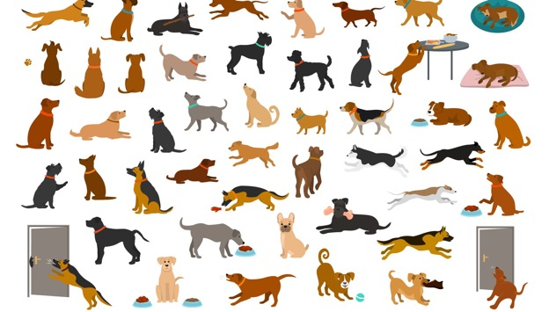

Pet Allergy Diagnostics Market Data

Slide 6
Pet Allergy Diagnostics Market
Global: $370M (2025) → $714M (2035)
EU is fastest-growing region
Diagnostics driven by insurance, dermatology and vet margins

Slide 7
Pet Allergy Diagnostics Market
Global: $370M (2025) → $714M (2035)
EU is fastest-growing region
Diagnostics driven by insurance, dermatology and vet margins

Slide 8
Segmentation
By test type: LFIA, ELISA, Dot Arrays
By channel: clinics, specialists, distributors, D2C
By species: dogs (~75%), cats (~25%)

Slide 9
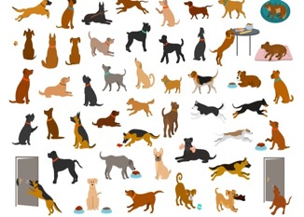

REGULATIONS
Product Classification :
classified as Veterinary Medical Devices (VMDs).
CE Marking
not mandatory for all VMDs, but it is recommended to become rapidly ISO 9001 and 13485.
Marketing Authorization (MA)
mandatory for VMD providing Technical Documentation Proof of Performance/Validation AND required Labeling Reg in the official language of each country of sale.
Diatech as Importer:
Responsible for the Chinese manufacturer's quality compliance and for having complete technical documentation.
Mandatory registration as an economic operator with the competent authority for each country

Slide 10
Competitive Landscape
Lab IgE panels: detailed but slow & expensive
Existing rapid tests: inconsistent quality
Specialists: limited throughput
DIATECH: Fast + Accurate + Affordable + Scalable

Slide 11
Pricing Benchmarks
Lab IgE panels: €85–150
Rapid tests: €28–45
Dot arrays: €120–180
Proposal DIATECH Rapid Test: €35–39
Proposal DIATECH Array: €120–150

Slide 12
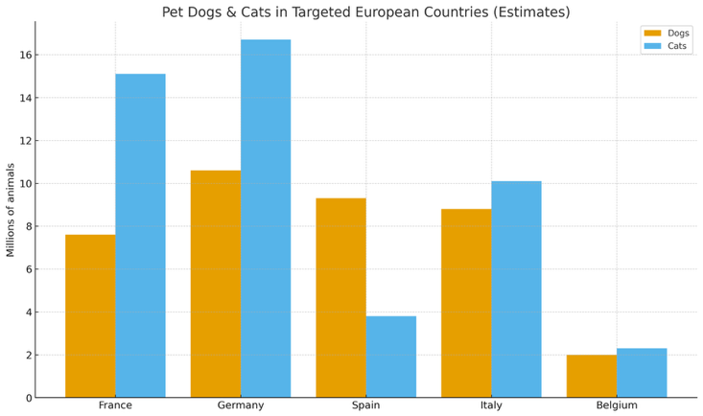
Market by countries

Slide 13

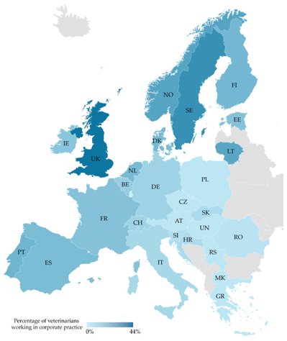
Percentage of Veterinarians working in Clinics structure

Slide 14
EU5 Prioritisation
France: High potential / Medium complexity
Italy: High potential / Medium complexity
Spain: Medium potential / Low complexity
Germany: High potential / High complexity
Belgium: Low potential / Easy entry

Slide 15
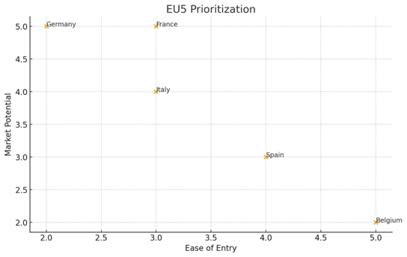
EU5 Prioritisation
Average Revenue of Vet Per Pet Owner
ARPU

Slide 16

France – Overview

Slide 17
France – Overview
~7,200 clinics
High dermatology caseload
Strong distributors: Centravet, Alcyon, Coveto

Slide 18
France – Market Potential
230k–290k tests annually
High willingness to adopt rapid testing

Slide 19
France – Competitive
Lab panels strong but costly
Rapid tests: low CE compliance
Specialists overloaded → clinics need tools

Slide 20
France – Go-to-Market
Phase 1
KOL network AFVAC Veterinary association including Belgium
Phase 2
Distributors onboarding
Phase 3
Direct-to-clinic activation
Phase 4
Upsell arrays + reader

Slide 21

Italy – Overview
High dermatology culture
Key distributors: Agrisan, Virbac Italy

Slide 22

Spain – Overview
Price-sensitive but easy entry
Key distributors: Distrivet, Covetrus Iberia

Slide 23

Germany – Overview
Highest ARPU Average Revenue Per User
Strict regulations
Long-term strategic market

Slide 24

Belgium – Overview
Small market, easy entry
High distributor centralisation
High level KOL

Slide 25
Thank You

